Slide 1
Time to Think & the Thinking Environment
“How good boards become great boards depends critically on the quality of their conversations… Action at board level is essentially thinking and conversation is thinking out loud at the highest level of the enterprise”
The Good Governance Forum, 2012
Here in the 21st Century, thinking for yourself is still a radical act.

Slide 2
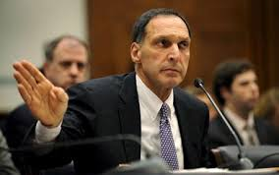
To say he was surrounded with a cult of personality would be an understatement. He was the textbook example of the command and control CEO. …Those closest to him slaved like courtiers to a medieval monarch…. Insulating him from trouble…. From almost anything he might not want to hear
Sunday Times, 14 December 2008
Dick Fuld, CEO Lehman Brothers

Slide 3
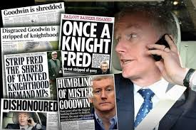
Goodwin exercised control through a daily 9:30am meeting where he would quiz managers about their competence. One morning he reduced a senior executive to tears. It wasn’t a positive or healthy atmosphere … you have to wonder about the decisions people make in that environment.
FT, 25 February 2009
Fred Goodwin

Slide 4
Airmic Study – Roads to Ruin
Dominant personalities or groups
Inappropriate allocation of time to matters requiring discussion or debate
Lack of preparation in advance of the meeting
An unhelpful manner of presenting information to the board
Fear

Slide 5
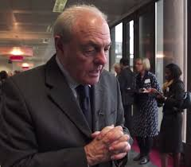
Beyond 20 Seconds - the independent mind of the board.
We cannot solve the problems of the 21st century with the 20th century mindset that created them.
Notes:
What would happen if the quality of the attention we received as we were speaking was such that we were not interrupted but instead encouraged to go beyond 20 seconds, think freely and independently, liberated from the need to impress, please, be ‘right’ or say the first thing that came into our heads because we know we are unlikely to get the change to think furher than 20 seconds will allow?
What ideas might be explored, flourish?
What might that mean for relationships, groups, teams, the Board, the organisation, society and the World.

Slide 6
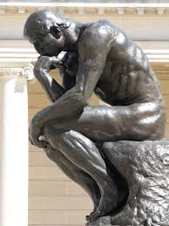
Time to Think
Everything we do depends on the quality of the thinking we do first. Our thinking depends on the way we treat each other while we are thinking.

Slide 7
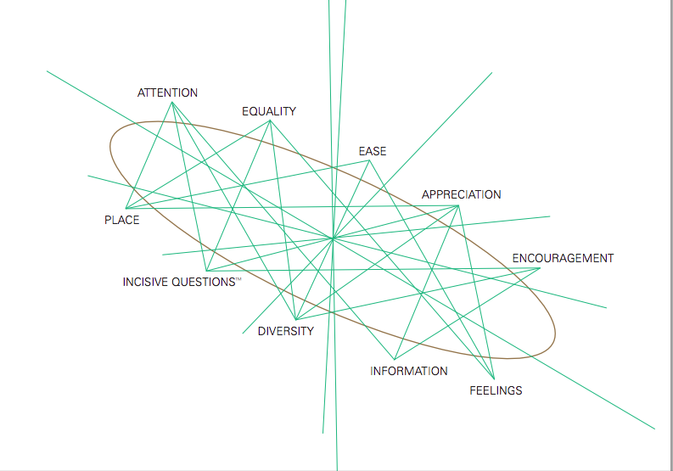
The Ten Components

Slide 8
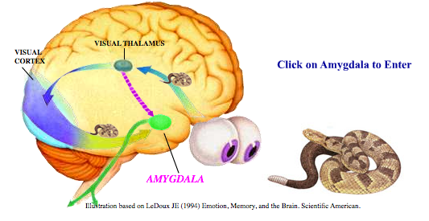
FEAR
Notes:
We now know that our brains and nervous systems are not insular but are profoundly affected by the brains and nervous systems of those around us through a finely balanced communication loop. Lewis, Amini and Lannon⁷ coined the term “limbic resonance” for this, whereby the limbic brain of one person is delicately attuned to the internal state of another. “Limbic resonance” is something we achieve when we are resonant with another, reading their emotions, detecting how they are feeling and even sensing what they will do next, as they read ours and hopefully meet our needs too.
The amygdala, the area of the limbic brain associated with memory and the emotions, directs us either to Approach or Avoid according to which emotions are activated. Fear, anger, disgust, shame and sadness are the avoid emotions driven by the “survive” need, love, trust, joy and excitement are driven by the “thrive” need.
The neuroscience also suggests that when a person is in the presence of the quality of attention generated by the Thinking Environment, ‘approach’ hormones such as serotonin, endorphins and oxytocin bathe the cortex, creating the conditions for quality interactions to take place.
On the other hand, if this seamless attention is shattered by interruption or intervention, ‘avoid’ hormones such as adrenalin and cortisol can begin to bathe the cortex, and thinking can slow down. In effect, when we come in too soon, we can extinguish fresh, even brilliant, independent thinking.
These concepts give us a new perspective on how we might grow the thinking and other capabilities of our leaders by reducing the factors that lead to Avoidance and increasing the factors that lead to Approach.

Slide 9
Two Worlds of Thinking
Exchange Thinking Independent Thinking
Notes:
Exchange Thinking – in classrooms, universities, training departments and is endemic in the professions.
It manifests itself in the Hierarchy of Thinking that exists in the Boardroom.
Characterised by the known, the complete, the transferable, solid.
This world is large and heavily populated, popular, rewarded, and standard in the world. It goes back and forth and can be labelled conversation, debate, advising, consultation, education, and brainstorming.
At worst it includes interruption, tailgating, distraction, rush and listening to reply/ impress/ correct/ clarify, confirm/ complete.
This world also produces adrenaline. It can be creative, exciting, dull or damaging and is how most interactions take place between people every day.
Independent Thinking
Is where one person's fresh thinking is activated by the listener's profound interest in where the 'thinker' will go next.
Fully independent thinking is a world of the new, the unfinished, the unknown and unknowable, the fresh, the leap, the loose.
It requires people to engage in exchange of ideas with keen awareness of equality of turn, with a generative quality of attention, with agreement of no interruption and the application of Ten Components (see later) that together create a Thinking Environment.

Slide 10
The Thinking Environment
A surfacing of better ideas, resolution of issues and greater structure and rigour including better preparation.
An environment where people can and do think independently for themselves regardless of hierarchy and power differentials.
A more trusting and less competitive environment.
Meetings that are more mindful, improve team performance and even well-being.

Slide 11
Time spent in meetings
Human capital cost of approximately $14.1bn per year not including meeting infrastructure costs.
Notes:
To make optimal workplace decisions, effective meetings are needed which generate high cognitive performance, employee engagement and trust. Research suggests many meetings fall short of this, resulting in unintended and expensive consequences for both companies and employees. Indeed, an unofficial estimate of the time spent in meetings for GE employees and contractors equates to a human capital cost of approx. $14.1BNper year, not including meeting infrastructure costs

Slide 12
Thinking Pairs
If we knew we could conduct better
more productive meetings,
what would change
For us?
What more do you think
Or feel
Or want to say?

